Slide 1

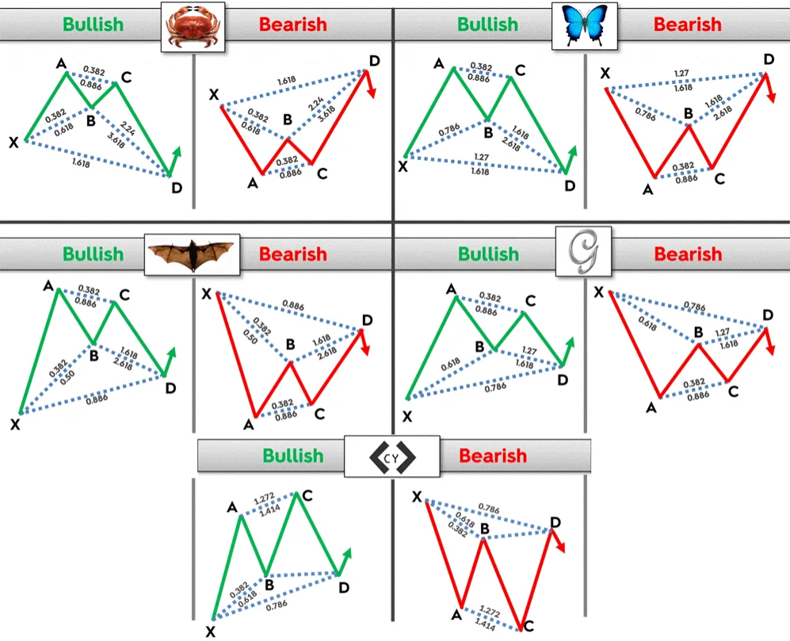
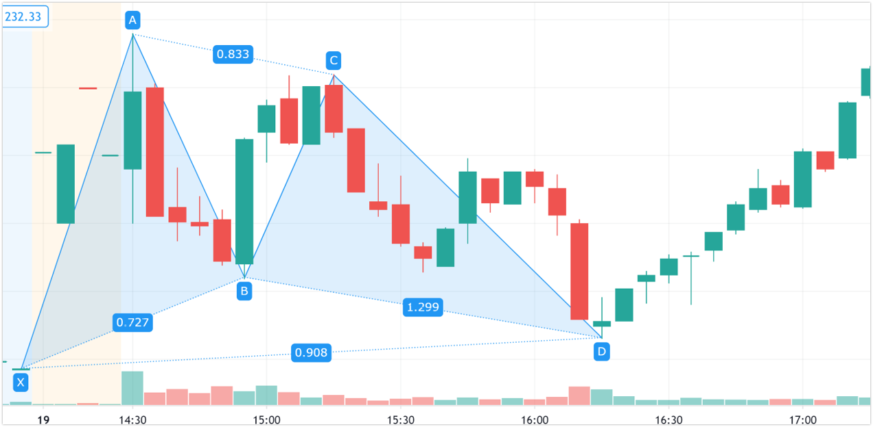
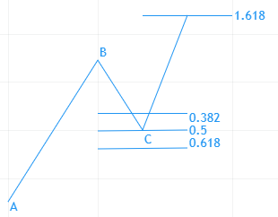
Gartley Patterns
James Lagese, Nikitas Missos, Derek Miller, Madison Ricciuti, and Morgan Weinreber
Advised by: Dr. Moon Nguyen and Dr. Thomas Wakefield
Youngstown State University, Youngstown, OH
Abstract
Types of Harmonic Patterns
Trading Harmonic Patterns
The stock market is a major factor in most people's lives whether it be investing, retirements, or their job. In order to determine an effective way to trade we looked at Fibonacci numbers and Gartley patterns that occur naturally within the market. Understanding these patterns will help us recognize buy and sell points as well as building upon them to program machine learning to identify these patterns and trade on them.
Swings correspond to Fibonacci numbers​
XA-Moving from the X to the A there Is no specific requirement to move. Any change in price can fit it​
AB-The AB move should be about 61.8% of the XA move. If XA bullish, AB reverse price action and should be reaching 61.8%​
BC-This line should be the reverse of the AB. This should finish on 38.2% of Fibonacci level or 88.6% of AB​
Cd-It is reversal of BC “Then if BC is 38.2% of AB, then CD should respond to the 127.2% extension of BC. If BC is 88.6% of AB, then CD should be the 161.8% extension of BC.”​
AD-This is the final move of a typical Gartley pattern. It must be a 78.6% retracement of the XA move.
Methods
The Gartley Pattern is a harmonic pattern series that uses Fibonacci ratios to identify buying and selling points
The Gartley Pattern is based on the Fibonacci Sequence: 0, 1, 1, 2, 3, 5, 8, 13, 21, etc.
When you divide a number in the sequence by the previous number, the result gets closer to the golden ratio 1.618 as the sequences goes on.
The golden ratio shows up in the stock market. The Fibonacci Retracement of 61.8% is commonly used as a trading level in stock market charts including the Gartley Pattern.
Pattern Type | B of XA | C of BA | D of AB | D of XA
Gartley | 0.618 | 0.382-0.886 | 1.272-1.618 | 0.786
Bat | 0.382-0.5 | 0.382-0.886 | 1.618-2.618 | 0.886
Butterfly | 0.786 | 0.382-0.886 | 1.618-2.214 | 1.272
Crab | 0.382-0.618 | 0.382-0.886 | 2.24- 3.618 | 1.618
Cypher | 0.382-0.618 | 1.272-1.414 | Not Required | 0.786
Future Works
In the future we would like to develop machine learning to trade using the Gartley Pattern.​
Having a system would allow automatic buying and selling points due to different Gartley Shapes​
Continue to use Gartley patterns as indicators but incorporate other techniques to maximize accuracy and profits​
Simulate buying and selling using the machine learning on real time stocks
Example Within the Stock Market
Fibonacci Retracement
Conclusion
Gartley Patterns can be useful to use for predicting when to buy/sell​
Exact numbers are not needed, but the closer the better​
When buying in with a bullish pattern use the initial point as a stop-loss point to cut back on losses​
The process is difficult to automate so it can be tedious and require patience
Due to the volatility of the stock market this is not a 100% guarantee, but it can help determine buy/sell points​
References :BabyPips.com. (2017, July 13). Trading The Gartley Pattern. BabyPips. https://www.babypips.com/learn/forex/the-gartley-and-the-animals​
Duddella, S. (n.d.). Harmonic Patterns. StockCharts. Retrieved January 6, 2021, from https://school.stockcharts.com/doku.php?id=trading_strategies:harmonic_patterns%E2%80%8B​
Kuepper, J. (2020, January 16). Gartley Pattern Definition. Investopedia. https://www.investopedia.com/terms/g/gartley.asp​
All Gartley Patterns in the Stock Market were found and graphed by us using Tradingview's Gartley tool​

